Slide 1

PROJECT EXPO 2023
PREDICTION AND PREVENTION OF MYOCARDIAL INFRACTION USING IOT AND SOC WITH MACHINE LEARNING APPROACH

Slide 2
ABSTRACT
Our project proposes machine learning –based models to prevent, detect automatically and to provide a rapidly accurate physiological prediction of the severity of acute myocardial infarction (MI) from the perspective of physiology and from clinical features. The myocardial infarction is one of the most common cardiovascular diseases of the present time and it occurs as a result of myocardial distress leading to the death of myocardial tissue. By using the machine learning algorithms, we aim to provide an early detection of the disease for better guidance and also for prevention. This project can, thus potentially speed up the diagnosis of the acute MI in the cardio-emergency departments.

Slide 3
MAJOR COMPONENTS USED
AURDINO (3 QTY)
ECG MONITOR COMPONENT (1 QTY)
GPS MONITOR COMPONENT(1 QTY)
EMERGENCY DETECTION MONITOR(1 QTY)
CONNECTING JUMPER CABLES
BREAD BOARD
AURDINO CONNECTING CABLES (TO SYSTEM)

Slide 4
FUNCTIONS OF ECG MONITORING SYSTEM
USED TO MONITOR THE PERSON’S TO CHECK YOUR HEART'S RHYTHM AND ELECTRICAL ACTIVITY.
IT PROVIDES MINUTE WISE UPDATION ABOUT THE ECG OF THE USER WHO HAS IT IN A FORMAT OF A WATCH
THIS DETAILS ARE TRANSFERED USING NETWORK TRANSMISSION STATERGY

Slide 5
Functions of gps monitoring system
IT HELPS IN MONITORING THE GEOLOCATION OF THE USER TO UPDATE THE LOCATION TO THE EMERGENCY SERVICES IN TIME OF THE ABNORMAL SYSTEMS EXPERIENCED BY THE USER
IN CASE OF ANY EMERGENCY IT SENDS THE CURRENT LOCATION OF THE USER TO THE AMBULANCE SERVICES TO PROVID BASIC HEALTH ASSISTANCE
IT TAKES THE USER HEALTH STATUS FROM THE ECG MONITOR

Slide 6
FUNCTIONS OF EMERGENCY DETECTION MONITOR
BASICALLY THE FUNCTION OF THE EMERGENCY DETECTION MONITOR IS TO OBTAIN THE RECORD OF THE USER WHEN IT GETS ABNORMAL WHICH IS DETECTED BY THE ECG MONIOR
AT THE TIME IT SENDS THE EMERGENCY MESSAGE TO THE USER’S CONSULTING DOCTOR WITH A CURRENT BASIC MEDICAL REPORT OF THE USER
IT EVEN SENDS EMERGENCY MESSAGE TO THE USER’S CLOSE RELATIVES AS WELL AS THE NEARBY AMBULANCE SERVICE

Slide 7
BASIC FUNCTION OF THE SYSTEM
THE ABNORMAL CODITION IS NOTED BY THE ECG MONITOR AND WHICH SENDS THE MESSAGE TO THE CONSULTING DOCTOR IN A BASIC FORMAT
GPS MONITOR GETS TRIGGERED AND SENDS THE CURRENT GEOLOCATION TO THE NEARBY AMBULANCE SERVICE AS WELL AS THE CLOSE RELATIVES WITH A EMEREGENCY MESSAGE USING EMERGENCY DETECTION MONITOR TRIGGERED BY ECG MONITOR

Slide 8
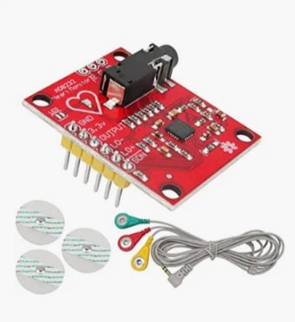


ECG MODULE COMPONENTS AND HEART RATE MONITORING SENSOR

Slide 9
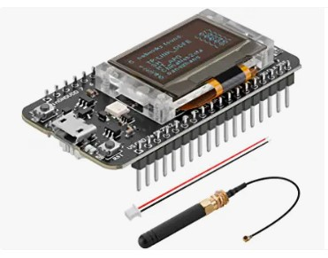
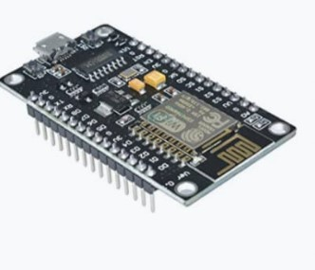
GLOBAL POSITIONING SYSTEM MODULE AND INTERNET DEVELOPMENT MODULE

Slide 10
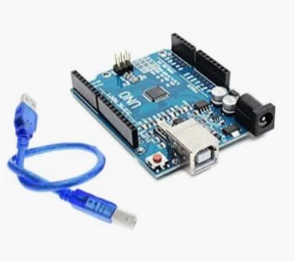


SOME BASIC COMPONENTS

Slide 11
TEAM MEMBERS
SRISIVASUBBURAMANYAM BS
THIRUMUKHIL S P
MELVIN M KURIAN
JEMILA NANCY

Slide 12
THANK YOU

